Slide 1
Annual Report & Analysis of Retail Sales: 02/2024 – 02/2025
Randy Grullon

Slide 2
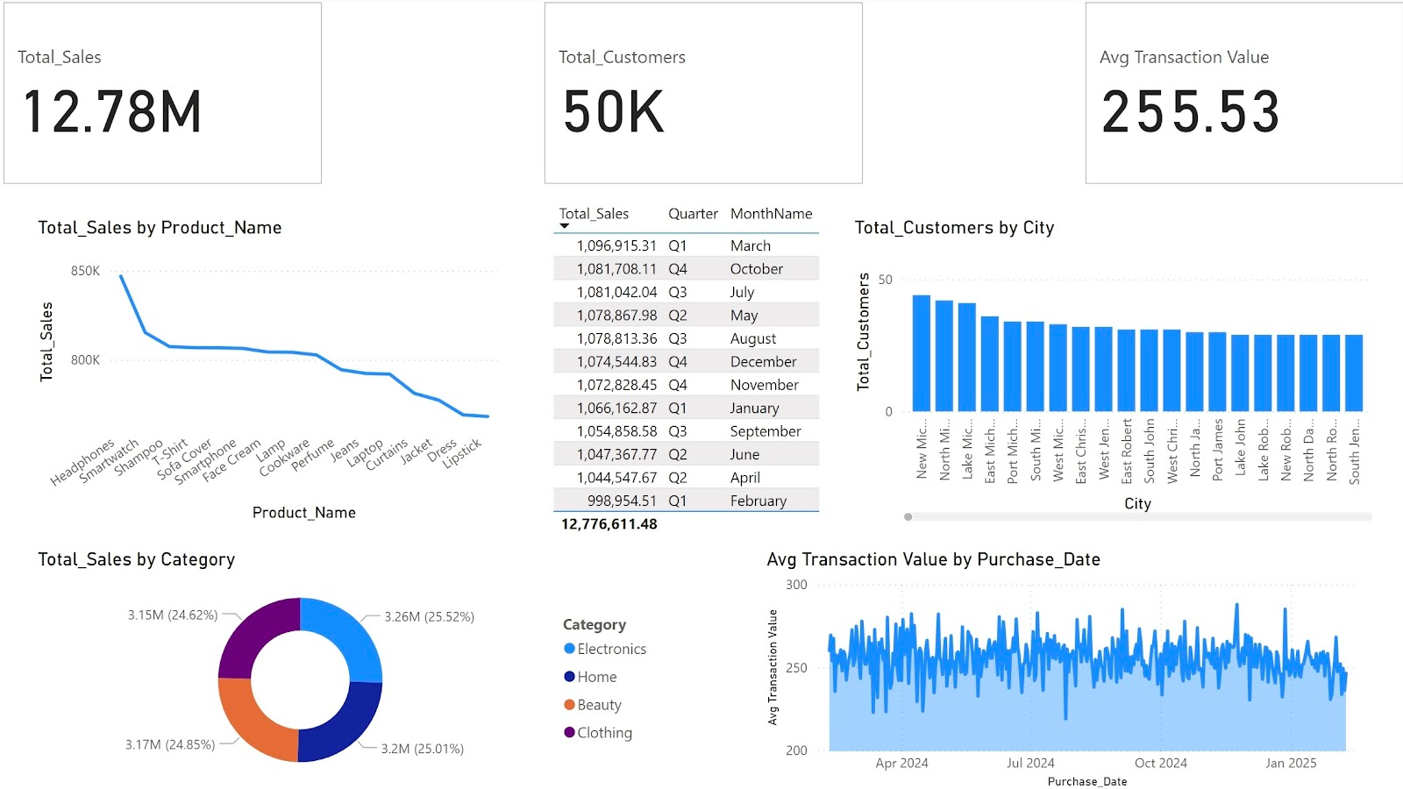
Report Of All Sales
From February of 2024 to February of 2025, a summary of our total sales is reported and computed into descriptive statistics that is ready to be analyzed.

Slide 3
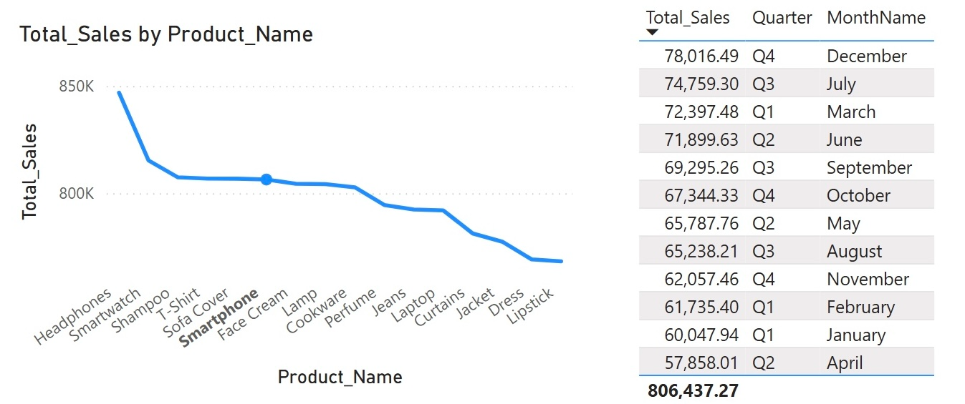
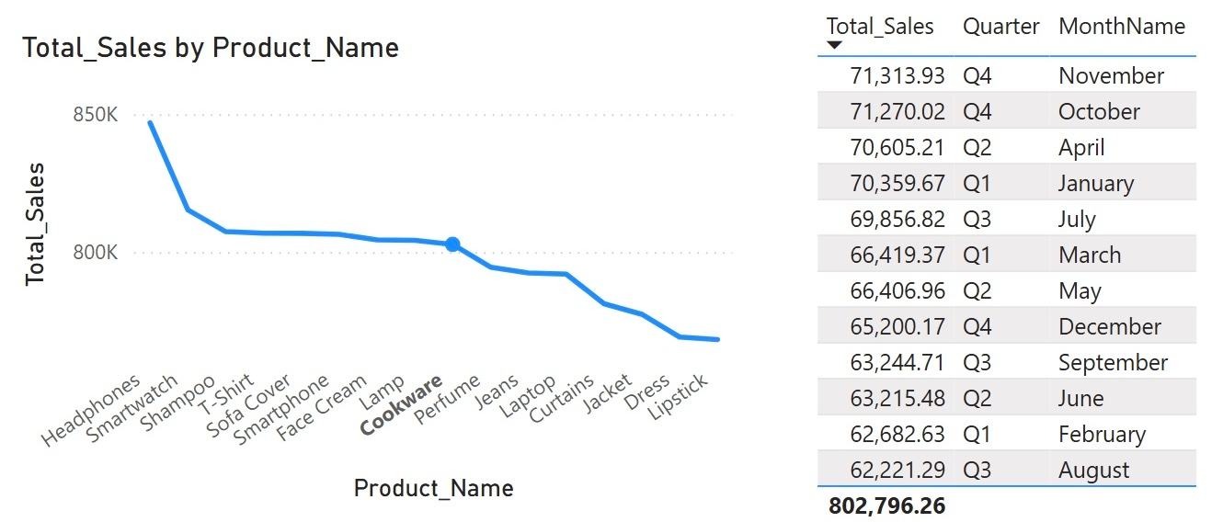
Monthly Sales Variability
Power BI’s interactive dashboard reveals that Smartphone sales are the least consistent with a high-low difference of $20,158.48 while Cookware is the most consistent with theirs being $9,092.64. In perspective, the average high-low sale difference is $14,503.72 while the median is $14,109.86.

Slide 4
Improving All Sales Consistency
Let’s understand why cookware’s stability is very high. It may be driven by the consistent demand for needing everyday household items. Whereas smartphone sales fluctuate more due to season promotions and simply the fact that a month-to-month purchase is not necessary per person.
We can adapt similar strategies into smartphone sales to drive more consistent sales.
If we strive to create bundled offers and loyalty discounts, our customers would have a strong incentive to purchase smartphones only from us rather than their cell provider, leading to a more improved sales consistency.
After implementation, we will compute the new sale numbers fora future report amongst smartphones. If our projection is correct, then this strategy will be applied to other products that have inconsistent sale patterns.

Slide 5
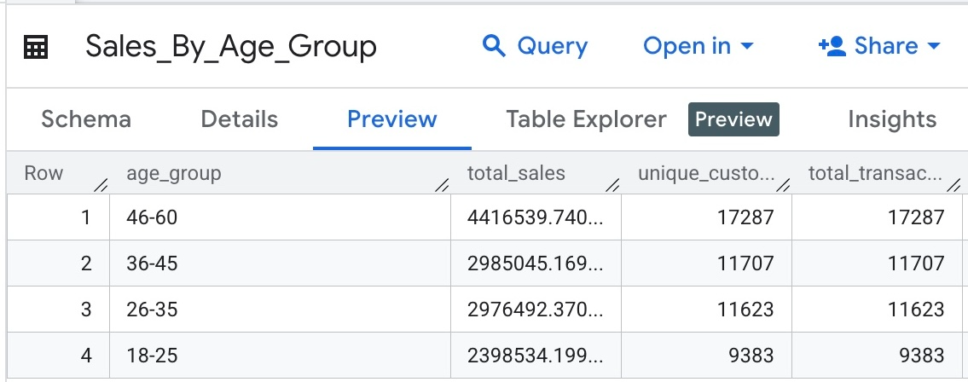
Age Group Sale Ratio
Using SQL code, this table was formed dividing different age groups and displaying their total sale value. Our most valuable group is the 46-60 year old bracket.

Slide 6
Age Demographic Revenue Alignment
With those figures being taken into consideration, we can make an analysis on why the 46-60 age bracket has the highest contribution. This could reflect a higher disposable income compared to younger age groups.
We will advertise school discounts with proof of ID.
Emphasize marketing on new trending products. Additionally, strive for more competitive prices against all adjacent suppliers to increase sales from the younger age brackets.
Conduct a future analysis and compare the new total sale values, striving to make each age bracket closer in sale revenue.

Slide 7
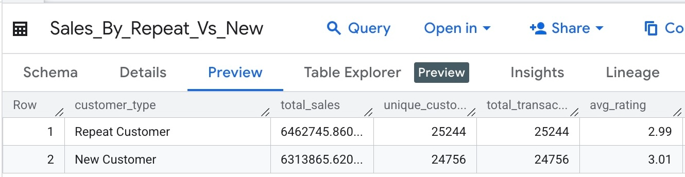
Repeated Vs New Customers
Furthermore, using SQL coding another key table was able to compute key figures.
Displaying that repeated customers generated slightly higher total sales ($6.46M vs $6.31M).

Slide 8
Retention Strategies
With benefits that are exclusive to repeated customers, we can incentivize repeated customers to increase purchase frequency as well as turning new customers into future repeated customers. We can implement the following benefits:
Early Access (To new products and or sales).
Personalized Offers (Specific discounts on products that are frequency purchased by the individual).
Online Benefits (Faster delivery options).

Slide 9
Anticipated Conclusion
Following implementation, it is reasonable to expect a modest improvement in total sales. If we project a feasible 3.33% increase into each identified key trend, it is plausible for a total sale increase of 10% to occur. This would translate into an anticipated annual sales figure of around $14.06M from February 2025 to February 2026.

